Slide 1
Multinomial analyses
R packages: “nnet” and “mlogit”
Ann Marie Gawel
LunchinatoRs 2020

Slide 2
Why use a multinomial regression?
Dependent variable consists of more than two categories
Presidential candidate of choice
Purchase options
Mode of transport
Independent variables can be factors, continuous, etc…

Slide 3
“multinom” example
Program
General
Academic
Vocation
~ SES: low/middle/high
~ write: continuous writing score
~ math: continuous math score
Prog ~ ses + math, data = ml

Slide 4
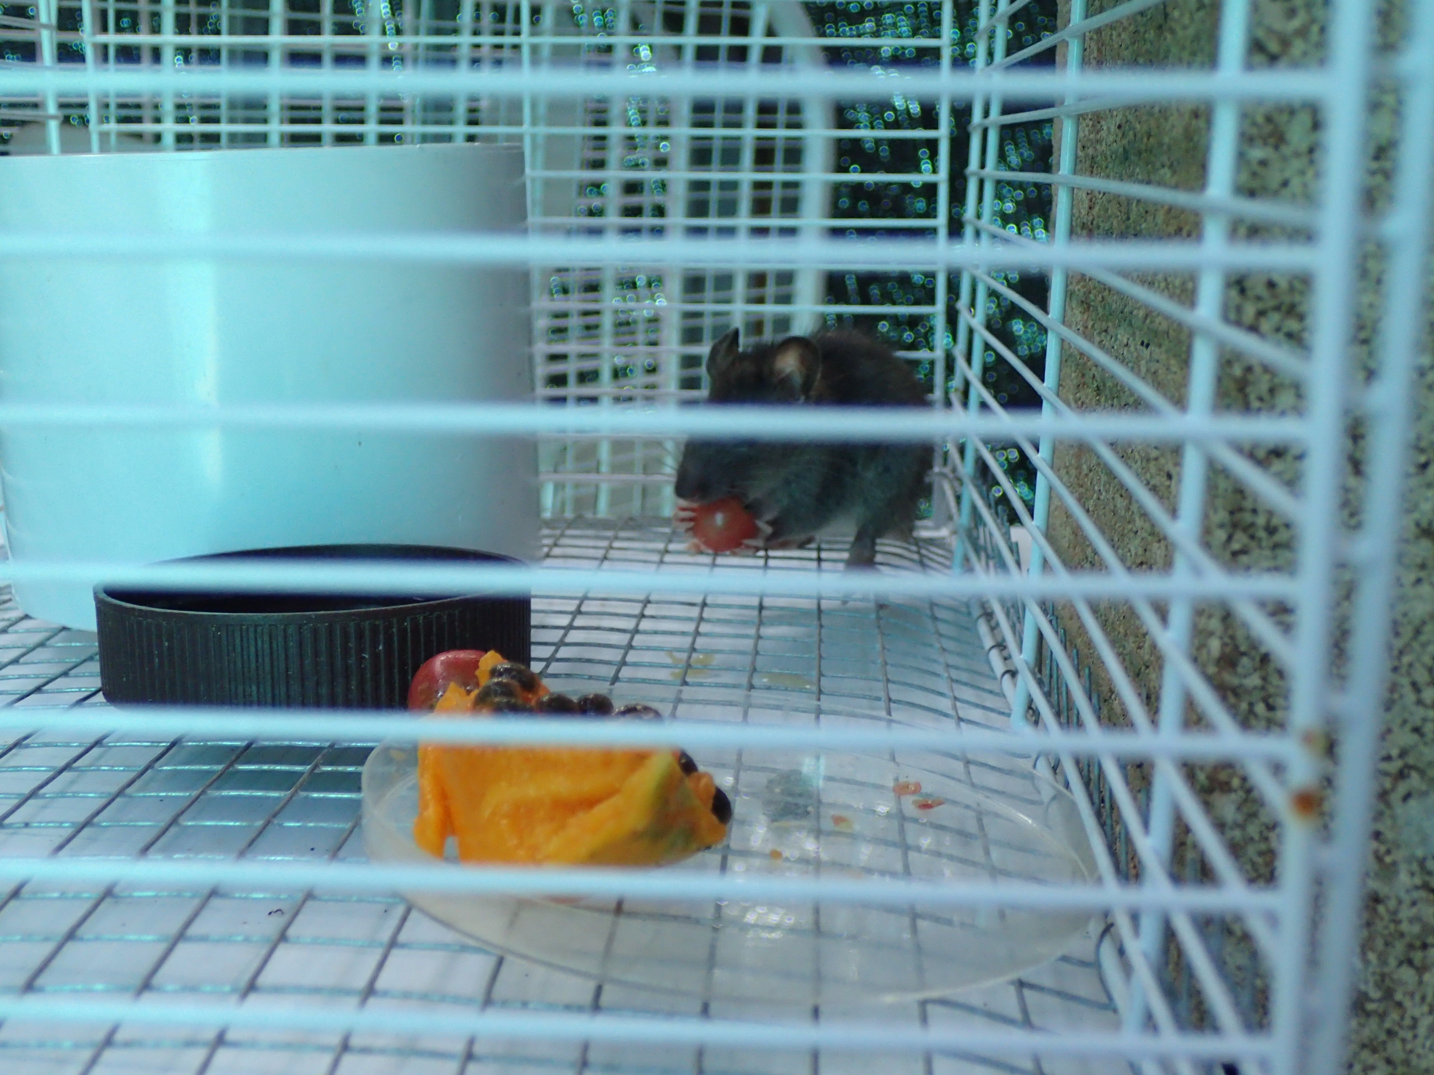

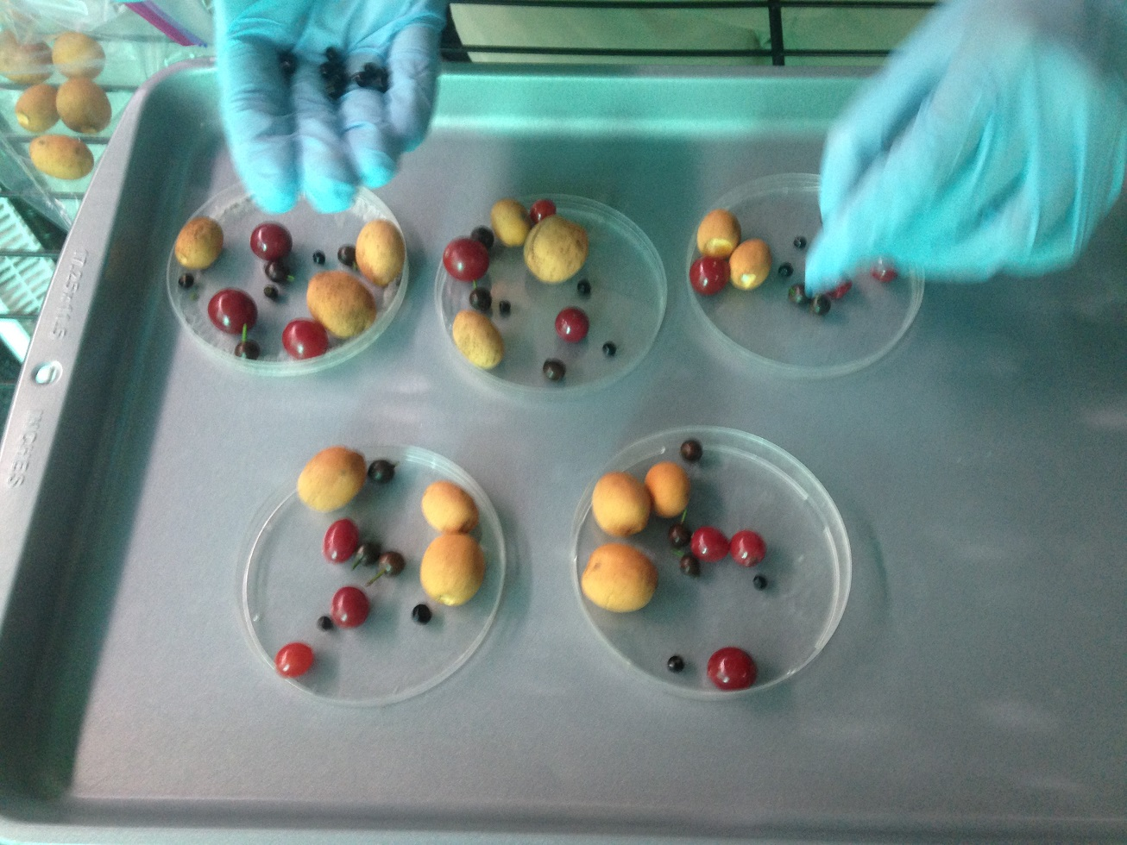
My project and dataset
Rat feeding trials
Ignore
Handle
Destroy
Gut-pass

Slide 5
My project and dataset
Rat feeding trials
Species
Site (fruit collected from)
RatID
Fate ~ species

